Slide 1

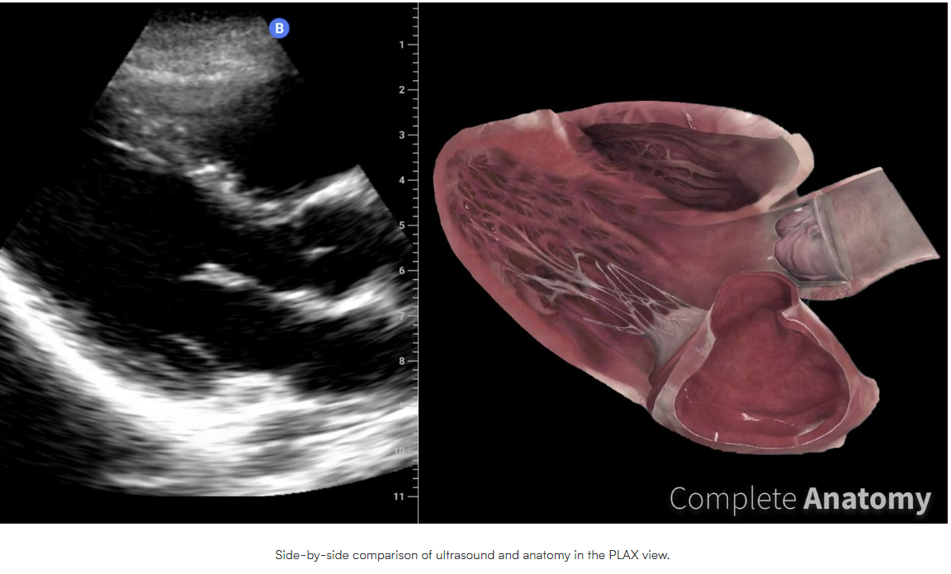

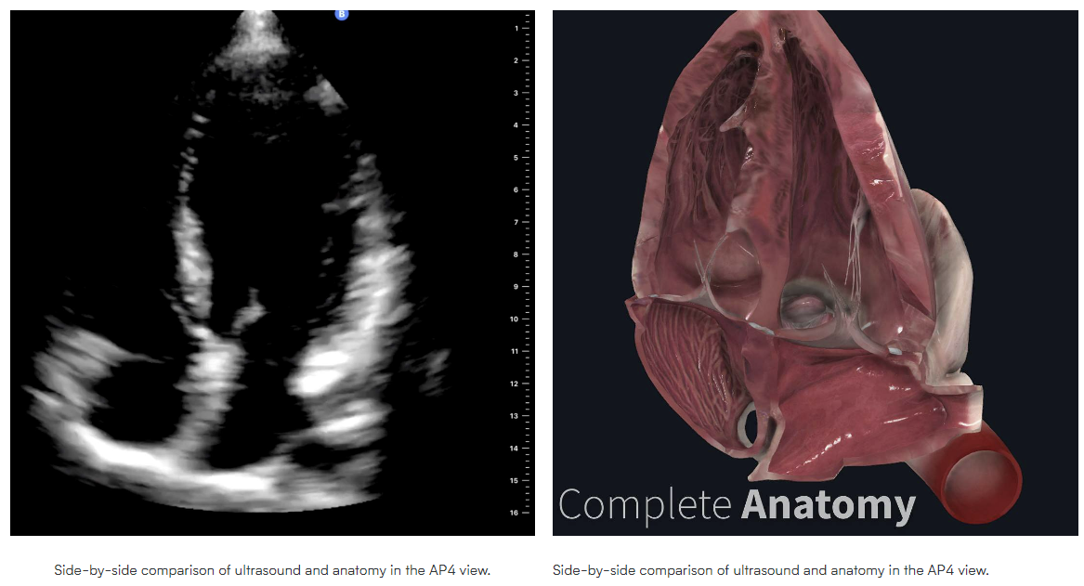
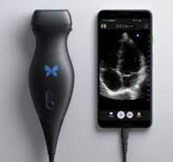

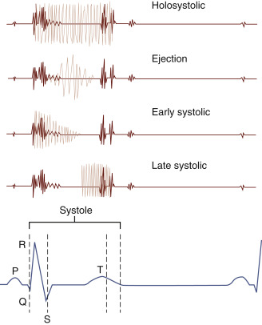
A Comparison of Pre-Clinical Medical Students’ Ability to Detect Heart Murmurs in Standardized Patients Using Point of Care Ultrasound vs. Auscultation
Rachel Boots, Alvin Nagi, Abigail Werhan, Sharad Nair, Omar Ajlouni, Ryan Ivey, Paul Misasi, Kimberly Long, PhD
Abstract
Proposed Analysis
Background: Point of Care Ultrasound (POCUS) is an inexpensive diagnostic modality that has been evidenced to show accuracy and efficiency in diagnosing heart murmurs. Further study into echocardiographic diagnosis, specifically point-of-care ultrasound, is warranted to establish an inexpensive but precise and accurate measurement tool for heart murmurs, and to determine if it is a more definitive diagnostic tool compared to heart auscultation alone.
Methodology: Pre-clinical medical students will complete 4 encounters with different diagnostic modalities (POCUS, standard auscultation, and digital auscultation), and will be asked to assess the presence or absence of a heart murmur.
Results: ANOVA testing will be completed to determine which detection methodology has the highest average number of correct heart murmur identifications.
Estimated Standardized Patient Assessments for Analysis | Assessments of Standardized Patients with Heart Murmurs | Assessments of Standardized Patients without Heart Murmurs
Traditional Stethoscope | 10 | 10
Digital Augmented Stethoscope | 10 | 10
POCUS | 10 | 10
Total Assessments: 60* | 30 | 30
Statistical Methods:
Data Analysis to evaluate for difference in murmur detection among modalities:
  ANOVA tests, F-value, p-value, confidence intervals, and Cohen's test for effect size
  Post-hoc analysis with significance corrections will be completed as appropriate.
  Evaluation for confounding, specifically students with prior clinical experience and levels of hearing loss.
Hypothesis
H₁: Pre-clinical medical students will have a greater rate of correctly identifying heart murmurs when utilizing POCUS compared to traditional auscultation and digital auscultation methods.
H₂: Pre-clinical medical students will have a greater rate of correctly identifying heart murmurs when utilizing digital auscultation compared to traditional auscultation and POCUS.
H₀: Pre-clinical medical students will have the same rate of correctly identifying heart murmurs across the three methods of POCUS, traditional auscultation, and digital auscultation.
Conclusions/Further Study
Proposed Methodology
This project is currently under review with the IRB at Kansas College of Osteopathic Medicine. The plan is to publish the study protocol over the summer and begin recruiting participants Fall 2023. After initial results from the Pilot study are complete, a repeat study will be conducted to compare the protocol between first year and second year medical students.
1. Review online module (Butterfly Academy)
Introduction
2. Attend training session with clinical faculty
Acknowledgements
Murmurs affect roughly 2.5% of the US adult population
Detected traditionally through auscultation, confirmed by echocardiogram
Low-grade murmurs often are missed on auscultation, especially during early medical training
Further study is needed regarding POCUS training in medical students and ability to detect murmurs utilizing various detection methods
Thank you to Kim Talbot, KERN, and the KansasCOM Simulation Center for their aid in recruiting standardized patient models.
Images and POCUS Training Protocol: Butterfly Academy and Complete Anatomy.
3. Complete 4 encounters
4. Record findings and Likert confidence rating following each encounter
References
Smythe J.F., Teixeira O.H., Vlad P., et. al.: Initial evaluation of heart murmurs: are laboratory tests necessary?. Pediatrics 1990; 86: pp. 497-500.
Silverman M.E., Wooley C.F., Samuel A.: Levine and the history of grading systolic murmurs. Am J Cardiol 2008; 102: pp. 1107-1110.
Bonow R.O., Carabello B.A., Chatterjee K., et. al.: 2008 Focused update incorporated into the ACC/AHA 2006 guidelines for the management of patients with valvular heart disease: a report of the American College of Cardiology/American Heart Association Task Force on Practice Guidelines (Writing Committee to Revise the 1998 Guidelines for the Management of Patients With Valvular Heart Disease): endorsed by the Society of Cardiovascular Anesthesiologists, Society for Cardiovascular Angiography and Interventions, and Society of Thoracic Surgeons. Circulation 2008; 118: pp. e523-e661.
Notes:
Smythe J.F., Teixeira O.H., Vlad P., et. al.: Initial evaluation of heart murmurs: are laboratory tests necessary?. Pediatrics 1990; 86: pp. 497-500.
Silverman M.E., Wooley C.F., Samuel A.: Levine and the history of grading systolic murmurs. Am J Cardiol 2008; 102: pp. 1107-1110.
Bonow R.O., Carabello B.A., Chatterjee K., et. al.: 2008 Focused update incorporated into the ACC/AHA 2006 guidelines for the management of patients with valvular heart disease: a report of the American College of Cardiology/American Heart Association Task Force on Practice Guidelines (Writing Committee to Revise the 1998 Guidelines for the Management of Patients With Valvular Heart Disease): endorsed by the Society of Cardiovascular Anesthesiologists, Society for Cardiovascular Angiography and Interventions, and Society of Thoracic Surgeons. Circulation 2008; 118: pp. e523-e661.

Slide 2
A Comparison of Pre-Clinical Medical Students’ Ability to Detect Heart Murmurs in Standardized Patients Using Point of Care Ultrasound vs. Auscultation
Rachel Boots, Alvin Nagi, Abigail Werhan, Sharad Nair, Omar Ajlouni, Ryan Ivey, Paul Misasi, Kimberly Long, PhD
Abstract
Proposed Analysis
Background: Point of Care Ultrasound (POCUS) is an inexpensive diagnostic modality that has been evidenced to show accuracy and efficiency in diagnosing heart murmurs. Further study into echocardiographic diagnosis, specifically point-of-care ultrasound, is warranted to establish an inexpensive but precise and accurate measurement tool for heart murmurs, and to determine if it is a more definitive diagnostic tool compared to heart auscultation alone.
Methodology: Pre-clinical medical students will complete 4 encounters with different diagnostic modalities (POCUS, standard auscultation, and digital auscultation), and will be asked to assess the presence or absence of a heart murmur.
Results: ANOVA testing will be completed to determine which detection methodology has the highest average number of correct heart murmur identifications.
Estimated Standardized Patient Assessments for Analysis | Assessments of Standardized Patients with Heart Murmurs | Assessments of Standardized Patients without Heart Murmurs
Traditional Stethoscope | 10 | 10
Digital Augmented Stethoscope | 10 | 10
POCUS | 10 | 10
Total Assessments: 60* | 30 | 30
Statistical Methods:
Data Analysis to evaluate for difference in murmur detection among modalities:
  ANOVA tests, F-value, p-value, confidence intervals, and Cohen's test for effect size
  Post-hoc analysis with significance corrections will be completed as appropriate.
  Evaluation for confounding, specifically students with prior clinical experience and levels of hearing loss.
Hypothesis
H₁: Pre-clinical medical students will have a greater rate of correctly identifying heart murmurs when utilizing POCUS compared to traditional auscultation and digital auscultation methods.
H₂: Pre-clinical medical students will have a greater rate of correctly identifying heart murmurs when utilizing digital auscultation compared to traditional auscultation and POCUS.
H₀: Pre-clinical medical students will have the same rate of correctly identifying heart murmurs across the three methods of POCUS, traditional auscultation, and digital auscultation.
Conclusions/Further Study
Proposed Methodology
This project is currently under review with the IRB at Kansas College of Osteopathic Medicine. The plan is to publish the study protocol over the summer and begin recruiting participants Fall 2023. After initial results from the Pilot study are complete, a repeat study will be conducted to compare the protocol between first year and second year medical students.
1. Review online module (Butterfly Academy)
Introduction
Acknowledgements
Murmurs affect roughly 2.5% of the US adult population
Detected traditionally through auscultation, confirmed by echocardiogram
Low-grade murmurs often are missed on auscultation, especially during early medical training
Further study is needed regarding POCUS training in medical students and ability to detect murmurs utilizing various detection methods
2. Attend training session with clinical faculty
Thank you to Kim Talbot, KERN, and the KansasCOM Simulation Center for their aid in recruiting standardized patient models.
Images and POCUS Training Protocol: Butterfly Academy and Complete Anatomy.
3. Complete 4 encounters
References
4. Record findings and Likert confidence rating following each encounter
Smythe J.F., Teixeira O.H., Vlad P., et. al.: Initial evaluation of heart murmurs: are laboratory tests necessary?. Pediatrics 1990; 86: pp. 497-500.
Silverman M.E., Wooley C.F., Samuel A.: Levine and the history of grading systolic murmurs. Am J Cardiol 2008; 102: pp. 1107-1110.
Bonow R.O., Carabello B.A., Chatterjee K., et. al.: 2008 Focused update incorporated into the ACC/AHA 2006 guidelines for the management of patients with valvular heart disease: a report of the American College of Cardiology/American Heart Association Task Force on Practice Guidelines (Writing Committee to Revise the 1998 Guidelines for the Management of Patients With Valvular Heart Disease): endorsed by the Society of Cardiovascular Anesthesiologists, Society for Cardiovascular Angiography and Interventions, and Society of Thoracic Surgeons. Circulation 2008; 118: pp. e523-e661.
Notes:
Smythe J.F., Teixeira O.H., Vlad P., et. al.: Initial evaluation of heart murmurs: are laboratory tests necessary?. Pediatrics 1990; 86: pp. 497-500.
Silverman M.E., Wooley C.F., Samuel A.: Levine and the history of grading systolic murmurs. Am J Cardiol 2008; 102: pp. 1107-1110.
Bonow R.O., Carabello B.A., Chatterjee K., et. al.: 2008 Focused update incorporated into the ACC/AHA 2006 guidelines for the management of patients with valvular heart disease: a report of the American College of Cardiology/American Heart Association Task Force on Practice Guidelines (Writing Committee to Revise the 1998 Guidelines for the Management of Patients With Valvular Heart Disease): endorsed by the Society of Cardiovascular Anesthesiologists, Society for Cardiovascular Angiography and Interventions, and Society of Thoracic Surgeons. Circulation 2008; 118: pp. e523-e661.

